Slide 1


Florida’s Ethics Law Training
Presented by:
Andrew H. Cohen, Esq.
April 30, 2026
Elected Officials Training

Slide 2

Florida’s Ethics Law:
.
Florida Statutes 112.3145 requires that designated elected officials (including elected Special District officers):
[C]omplete 4 hours of ethics training each calendar year* which addresses, at a minimum, s. 8, Art. II of the State Constitution, the Code of Ethics for Public Officers and Employees, and the public records and public meetings laws of
this state.
*Elected Special District officers are not subject to training requirements in the calendar year they are leaving office.

Slide 3
Florida Administrative Rule 34-7.025:
.
Fla. Admin. R. 34-7.025(2)(b) sets forth the topics that MUST be covered in training:
Doing business with one's own agency;
Conflicting employment or contractual relationships;
Misuse of position;
Disclosure or use of certain information;
Gifts and honoraria, including solicitation and acceptance of gifts, and unauthorized compensation;
Post-officeholding restrictions;
Restrictions on the employment of relatives;
Voting conflicts;
Financial disclosure requirements, including the automatic fine and appeal process;
Commission procedures on ethics complaints and referrals; and
The importance of and process for obtaining advisory opinions rendered by the Commission.

Slide 4

History
.
Article II, Sec. 8 was adopted by Florida voters in 1976 to provide for ethical conduct standards and disclosure requirements for public officers and employees.
Specified that the Legislature was to adopt the code of ethics for the public officers.
Art. II, Sec. 8, Fla. Const.

Slide 5
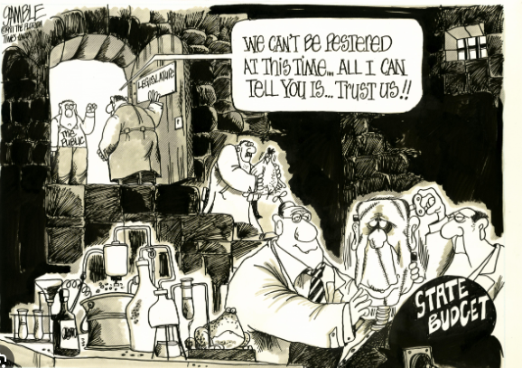
.

Slide 6
Scope - Florida’s Ethics Law*:
.
Article II, Section 8 of the Florida Constitution
- Mandates Ethical Conduct and Financial Disclosure
Part III, Chapter 112, Florida Statutes (Code of Ethics)
- Establishes the behavior/conduct standards
* Locally adopted Ethics Codes/Rules are Not Covered.

Slide 7
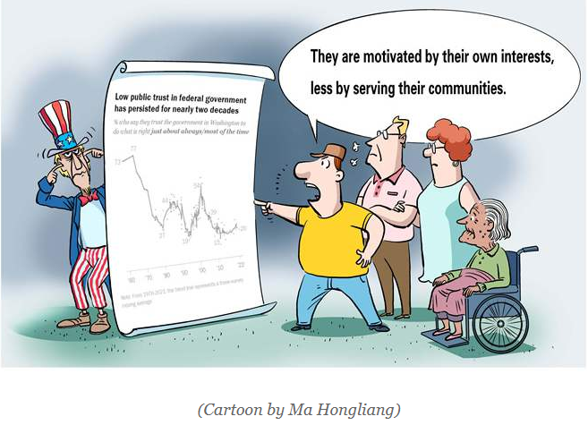
Ethics Code – Chapter 112, Part III, Fla. Stat.
.
Adopted in response to Constitutional mandate.
Legislates how public officials will meet transparency and public trust requirements.
Sets forth prohibited conduct and affirmative obligations.

Slide 8
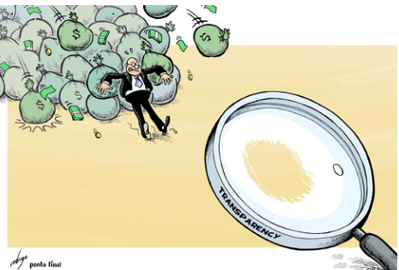
Florida’s Ethics Code : 2 Overriding Principles
1. Maintaining Public Trust
2. Transparency

Slide 9




Prohibited Conduct and Transactions

Slide 10

Prohibited Conduct– Gift Solicitation
Prohibited Solicitations: Elected Officials and their spouse/children are prohibited from soliciting or accepting gifts of any value based on understanding that the elected official would be influenced by the item.(i.e., vendor, contractors, etc.)
“Gift” is broadly defined. Includes loans, rewards, future employment, favor, etc.
Excludes gifts from relatives.
Fla. Stat. § § 112.313, 112.3148

Slide 11
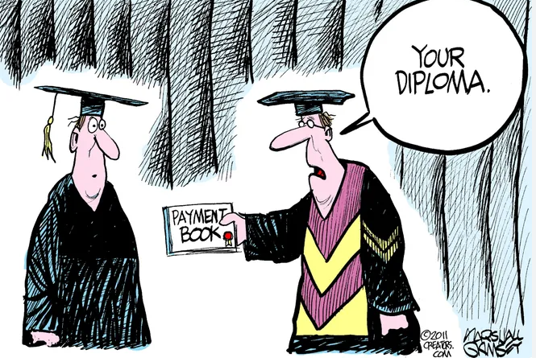
Prohibited Conduct: Soliciting Honorarium
Honorarium:
Payment of money or anything of value given as consideration for a speech or other written/oral presentation (other than a book).

Slide 12
Prohibited Conduct: Soliciting Honorarium
Special District officials are prohibited from soliciting honorariums or accepting them from PAC or lobbyists who lobbied the agency within 12 months.
This prohibition Does Not include payment of actual and reasonable transportation, lodging, food/beverage related to an event (incl. registration fee). Fla. Stat. § 112.3149

Slide 13
Prohibited Conduct – Business with Agency
Doing Business with One’s Agency – Includes 2 prohibitions:
(1) Public officials cannot directly or indirectly sell goods or services from the person’s business to the District. Prohibition applies to businesses owned by the official, official’s spouse or child.
(2) Public officials cannot act in a “private
capacity” renting, selling or leasing any goods/services to
their District.
See, Fla. Stat. § 112.313

Slide 14
Prohibited Conduct: Conflicting Employment
Conflicting Employment/Contractual Agreement – Includes 2 prohibitions:
Prohibits officials from having an employment or contractual relationship with the public entity that is regulated by the public entity;
Prohibits officials from having an employment or contractual relationship that will create a continuing or recurring conflict of interest.
See, Fla. Stat. § 112.313 (7)

Slide 15
Prohibited Conduct: Misuse of Position
Misuse of Public Position – Prohibits officials from “corruptly using” position for yourself or others. Fla. Stat. § 112.313 (6)
“Corrupt” determination is based on facts; generally, it is interpreted as being done with a “wrongful intent” that is inconsistent with the official’s proper performance of duties.
Caselaw construed this to require proof that the official had notice his/her conduct was inconsistent with duties and a violation of ethics code.

Slide 16
Prohibited Conduct: Relative Employment
Nepotism –Prohibits officials from seeking advancement or employment of relatives. See, Fla. Stat. § 112.3135
May not appoint, employ, promote, advance or advocate for a relative in an agency position. Key is the exercise of control.
Statutory definition of “relative” limited to specific familial relations:
Father
Mother
Son
Daughter
Brother
Sister
Uncle
Aunt
First Cousin
Nephew/Niece
Husband
Wife
In-laws
Steps
Halfs

Slide 17
Additional Prohibited Conduct
Improperly Disclosing Information – Prohibits the use of information not available to the public for the benefit of yourself or others. Fla. Stat. § 112.313 (8)
Post-officeholding restrictions - Prohibits public officials from representing anyone before their government for 2 years after leaving office. Fla. Stat. 112.313(13), (14)

Slide 18

Prohibited Conduct: Disproportionate Benefit
Abuse of Public Position – Prohibits officials from obtaining a “disproportionate benefit” for yourself or others.
2018 Amendment to the Florida Constitution. See, Art. II, Sec. 8(h), Fla. Const.

Slide 19
Prohibited Conduct: Disproportionate Benefit
“Disproportionate benefits” defined by Florida Administrative Rules.
A benefit, privilege, exemption or result arising from an act or omission inconsistent with the proper performance of public duties. R. 34.18-001(3), Fla. Admin. C.
Violations of “disproportionate benefit” requires a wrongful intent through action or inaction that rises to the level of an intentional abuse of public position.

Slide 20
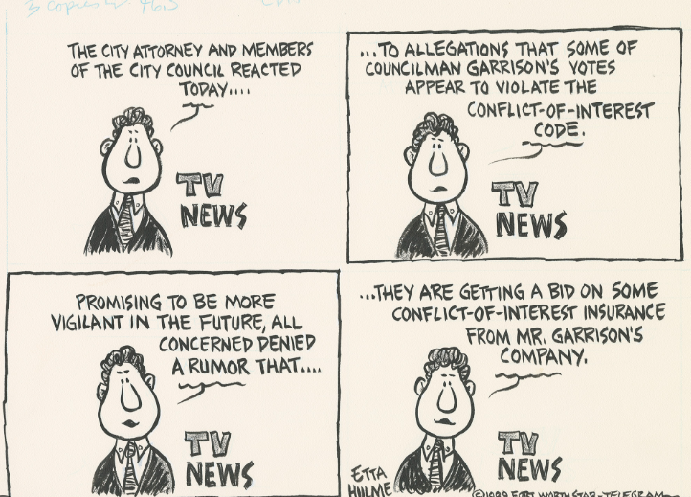
Prohibited Conflicts

Slide 21

Prohibited Conduct: Conflicts
  Florida’s Ethics Code is premised upon maintaining public trust by prohibiting public officials from using their office for “private gain”.
  Private gain generally means a public official’s financial interest is directly enhanced as a result of a vote, and there is a direct and immediate gain.
  Art. II, Sec. 8, Fla. Const.; Ch. 112, Fla. Stat.

Slide 22
Prohibited Conduct: Voting Conflicts
“Voting Conflict” means voting on a matter that will result in a special private gain or loss to the Board member or a person connected to them in a private capacity.
A voting conflict does not “void” the vote for the Board, and Florida law does not provide for a “cure.”
A voter conflict exposes the voting Board member to liability/exposure.
Fla. Stat. § 112.3143

Slide 23
Voting Conflict - Obligations
Voting restriction applies when there is a specific benefit to yourself, an employer, a principal or relative.
Must abstain from voting and refrain from discussion on any measure that creates a “special private gain or loss.”
If conflict is known, must publicly state to the assembly the nature of the conflict and abstain from voting.
Memorandum of Voting Conflict form (Form 8B) must be filed with the Clerk within 15 days.
Fla. Stat. § 112.3143

Slide 24

  Form 8 B – Memorandum of Voting Conflict
  Form 1 – Limited Financial Disclosure
  Form 9 – Quarterly Gift Disclosure (Recipient)
  Form 30 –Donor’s Quarterly Gift Disclosure
Transparency Requirements – Forms!

Slide 25
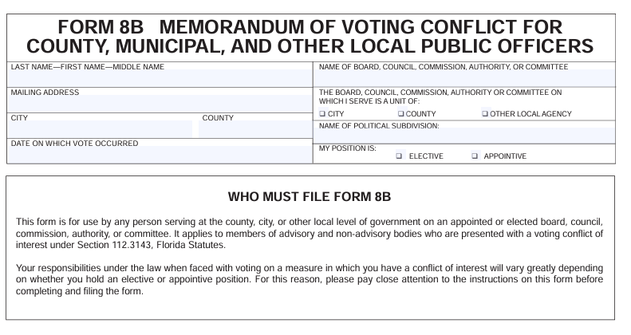
Form 8B – Memorandum of Voting Conflict

Slide 26
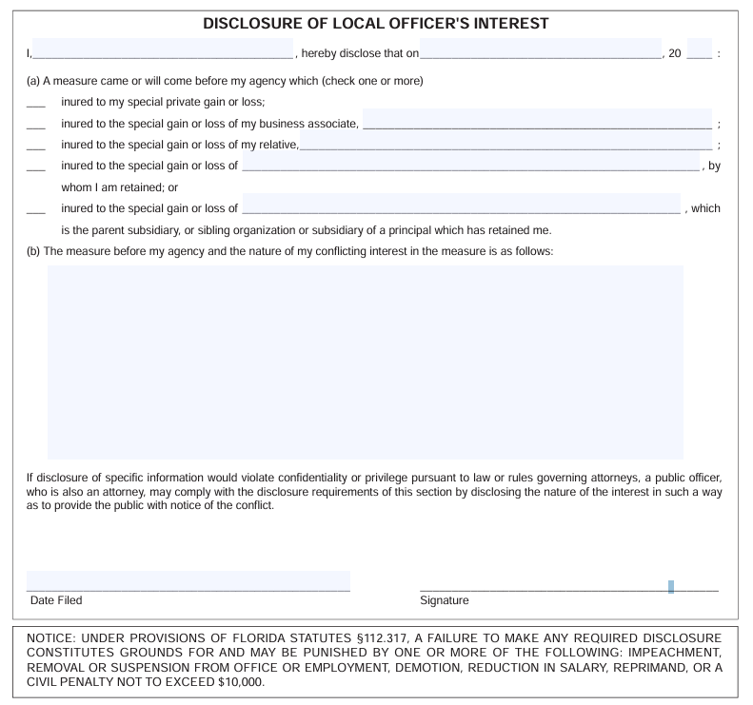
Form 8B – Memorandum of Voting Conflict
Fill in the Blank Form
Briefly Describe Conflict
Submit Completed Form to the Clerk who will Incorporate the form into the Minutes.

Slide 27
Form 1 – Limited Financial Disclosure
Elected and appointed special district officials must fill out Form 1 (Limited Financial Disclosure form) annually on or before July 1.
Requires the reporting of person’s sources and types of financial interests.
Does not require monetary values.
Form 1 MUST be filed electronically.
Must file within 30 days of appointment.
Form 1F is filed within 60 days of leaving position.

Slide 28
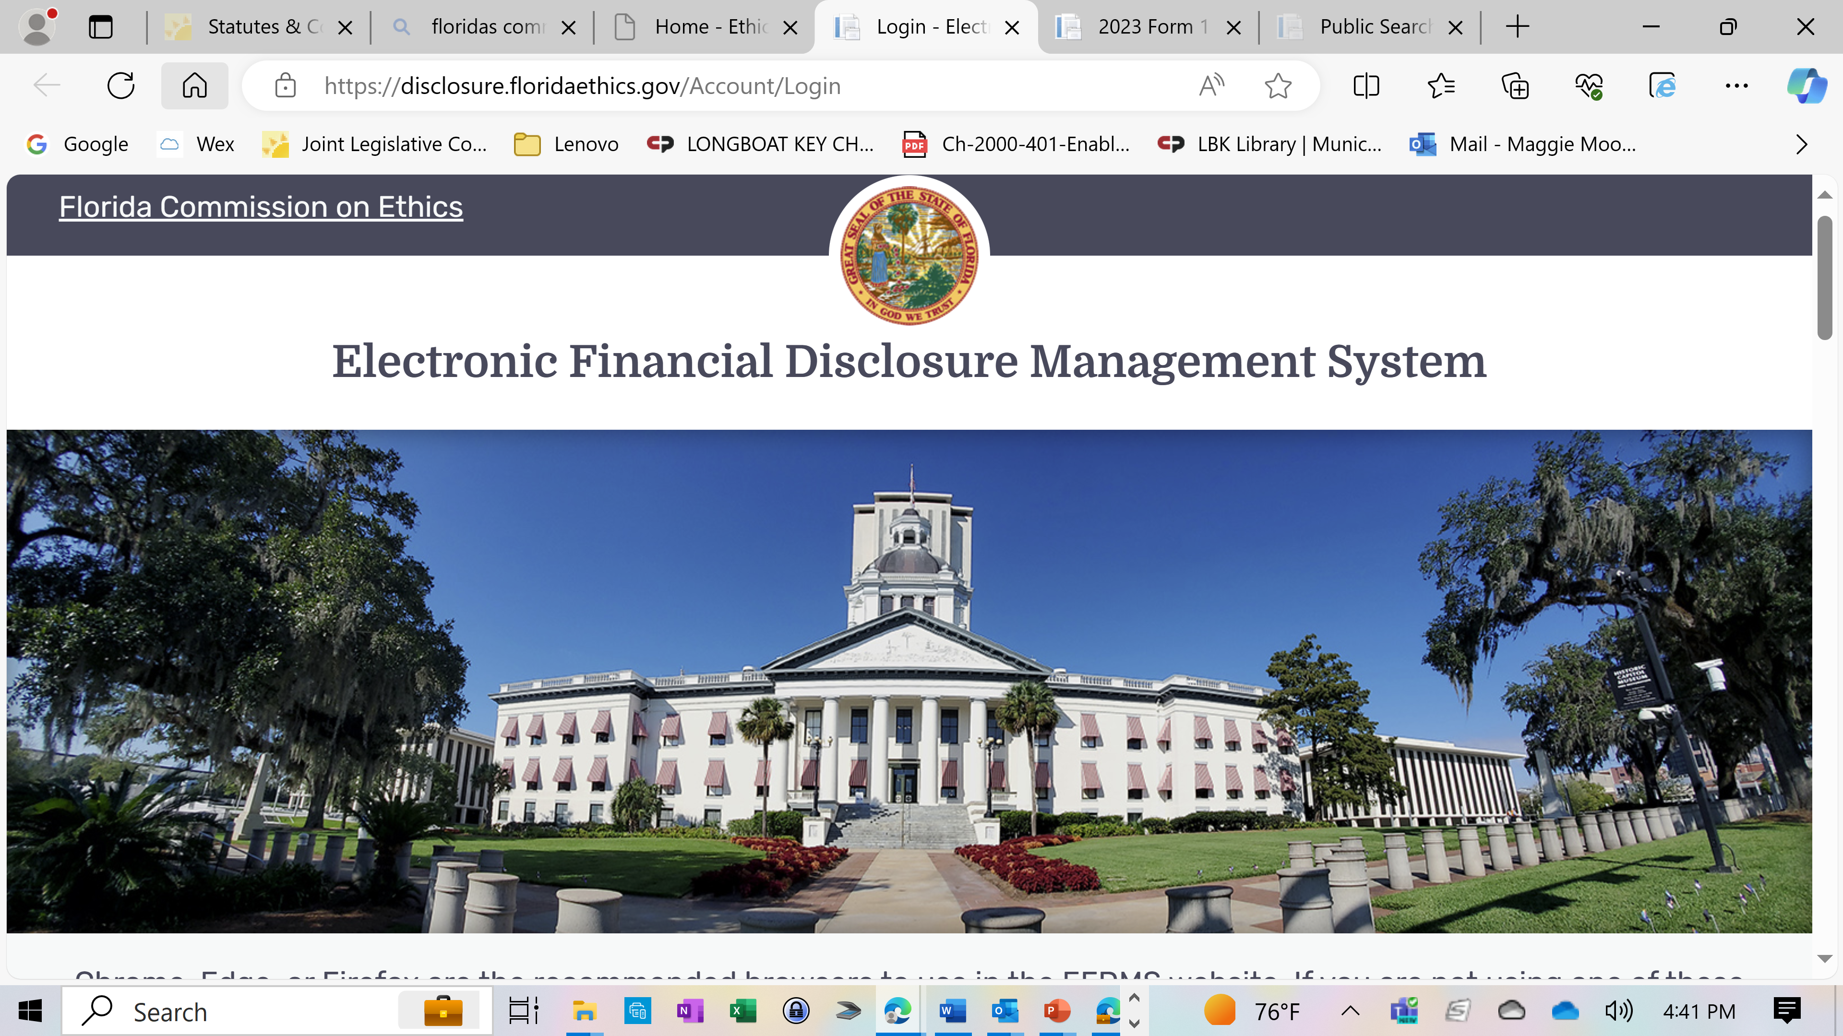
Form 1- Electronic Filing
Website for electronic filing

Slide 29
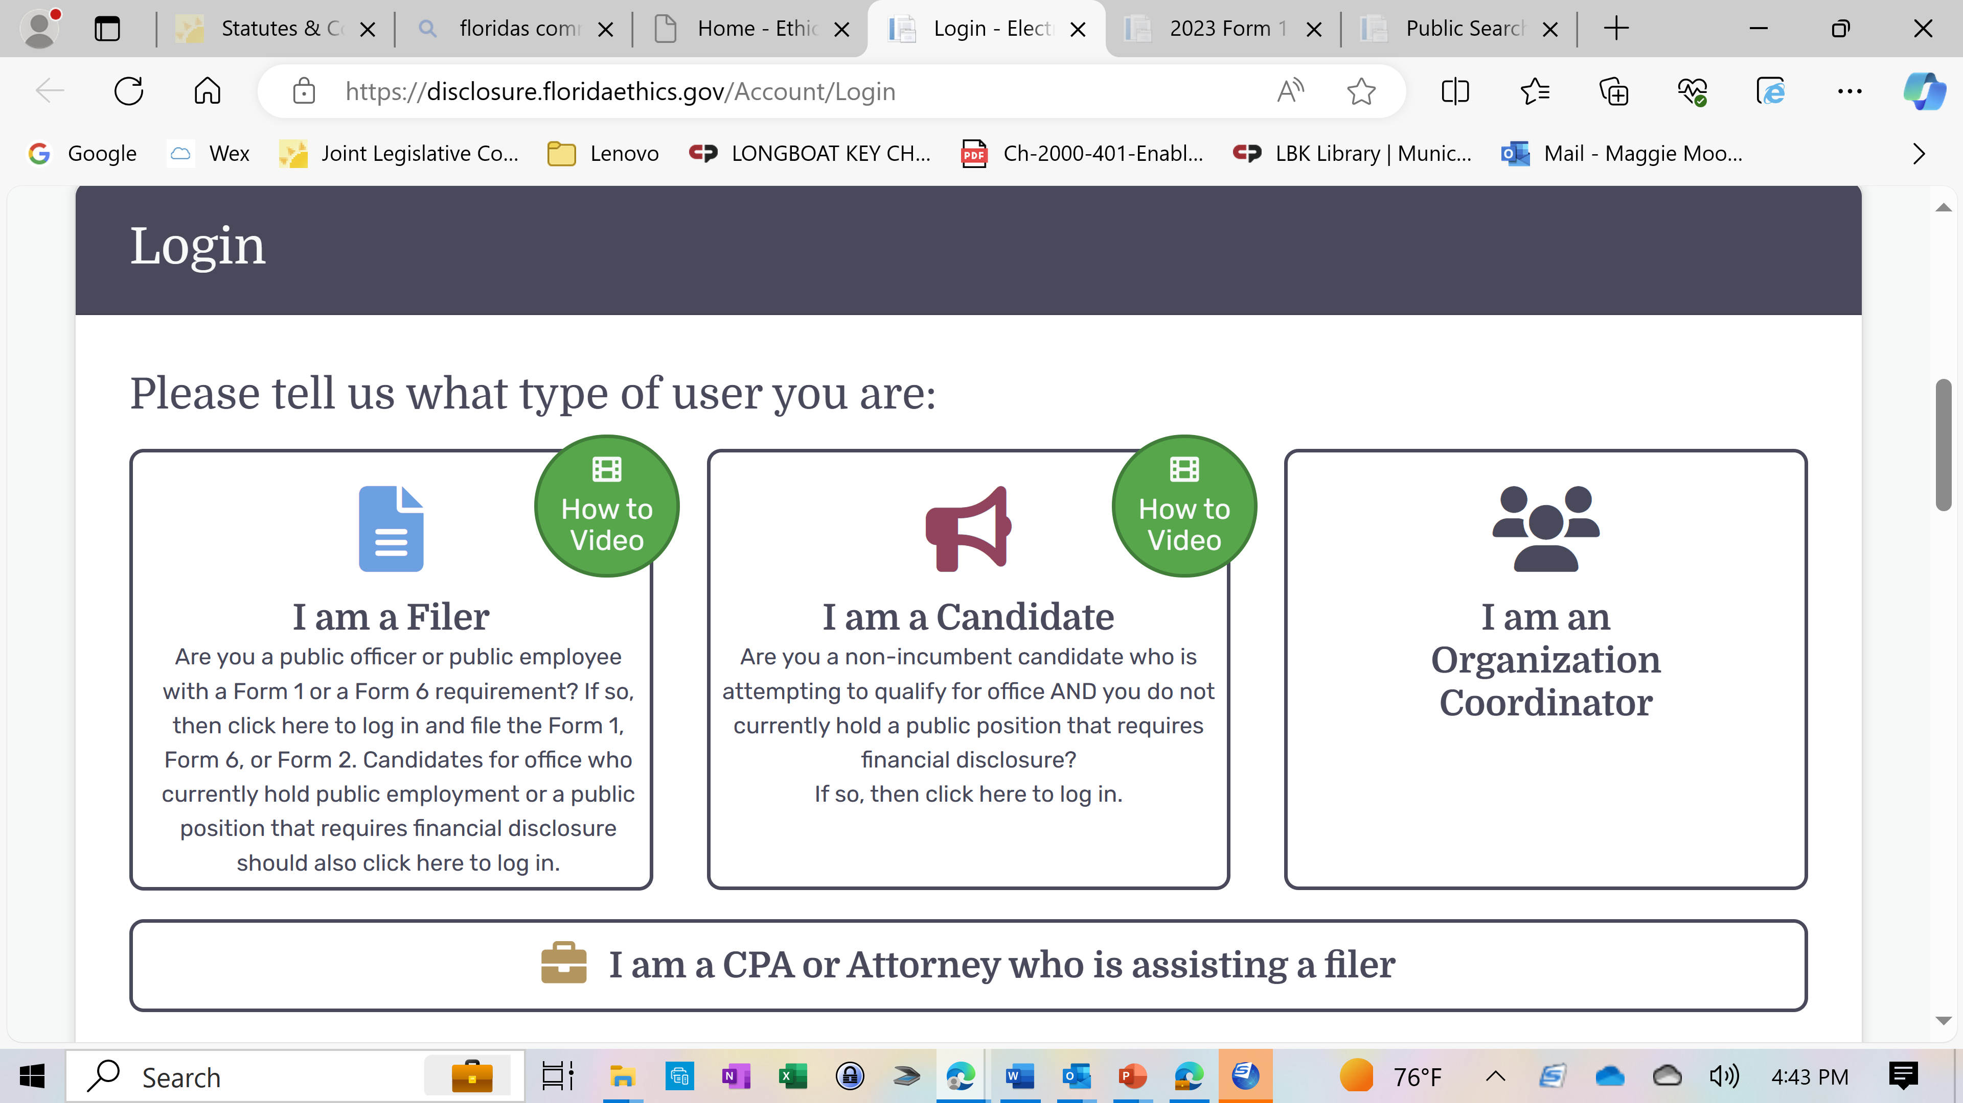
Form 1- Electronic Filing
MUST follow instructions to File Form 1 by July 1st.
Form should include field to confirm Ethics Class completion.

Slide 30
Form 1 – Deadline July 1
If Form 1 is not filed by Sept. 1, automatic fines accrue at $25/day, with a max penalty of $1500
Fines may be appealed but can only be waived by Commission on Ethics (COE) for “unusual circumstances”
COE can investigate officials for failure to file and can result in removal from office.

Slide 31
Transparency: Forms 9 and 30/Gifts
Acceptance of Gifts: Elected Officials may accept gifts valued between $25-$100 from a vendor/lobbyist doing business with the agency but the gift must be reported by the donor and reporting official. [Donor’s Form 30]
Gifts valued over $100 require disclosure on the Quarterly Gift Disclosure Form 9. [Reporting Individual].
There is no obligation to file a Gift Disclosure Form 9 if you have not received a gift!
Fla. Stat. § 112.3148

Slide 32
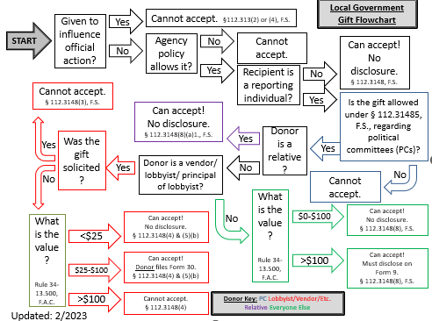

Prohibited Conduct– Gift Solicitations
Source: Prepared by Steven Zuilkowski, Deputy Executive Director and General Counsel, Florida Commission on Ethics

Slide 33
Florida Commission on Ethics
.
Created the Commission on Ethics to investigate complaints and breaches of public trust.
9 Member Commission that serves 2-year term:
  -5 appointed by Governor
  -2 appointed by President of the Senate
  -2 appointed by Speaker of the House
Members not permitted to hold public employment during their terms.
Meet in Tallahassee.

Slide 34
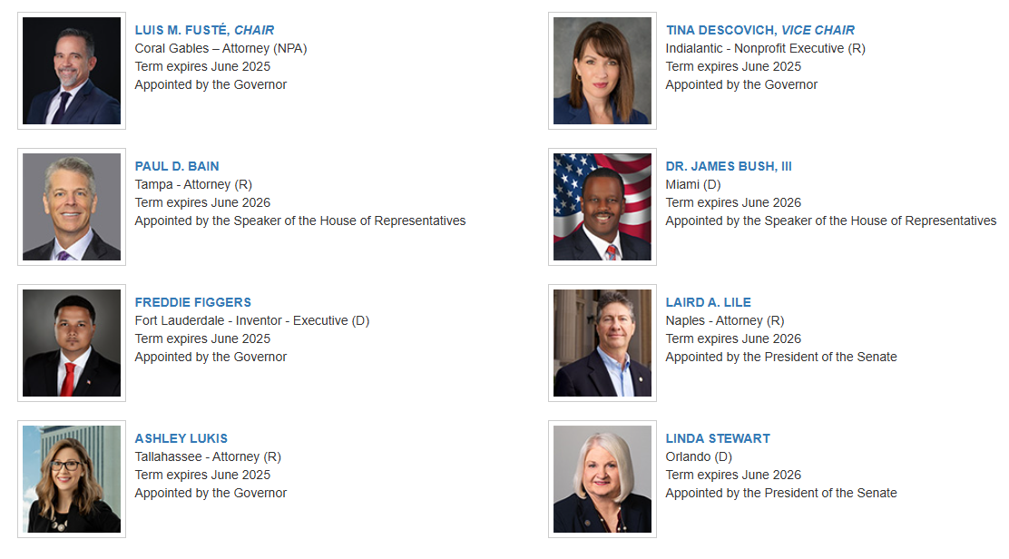
Florida Commission on Ethics (sample)
.

Slide 35
Florida Commission on Ethics
.
Can render legal advisory opinions to public officials seeking guidance.
Has Jurisdiction to review and investigate Ethics Complaints against individual public officers and employees for violation of the Florida’s Ethics Code.
They cannot conduct an investigation until a sworn complaint is filed.
They do not independently initiate an action even if there are newspaper articles, letters or phone calls.

Slide 36


Ethics Opinions:
Legally binding advisory opinions may be sought from public officers, employees or candidates from the Florida Commission on Ethics (COE).
Advisory opinions are binding on the conduct of the person who is the subject of the opinion.
Once issued and followed, the opinion provides a type of immunity from an ethics complaint for the individual seeking the direction.
Opinions are available on the COE’s website: www.ethics.state.fl.us.

Slide 37
Ethics Complaints:
An Administrative Complaint can be filed with Florida Commission on Ethics (COE).
Ethics Complaints are the easiest type of action to file!
Complaint form is available on COE website.
Complaint is investigated by agency investigator.
If probable cause exists, an administrative hearing is scheduled before the COE panel in Tallahassee to determine violation.
COE conducts a hearing, decides whether the law violated, and recommends a penalty.

Slide 38
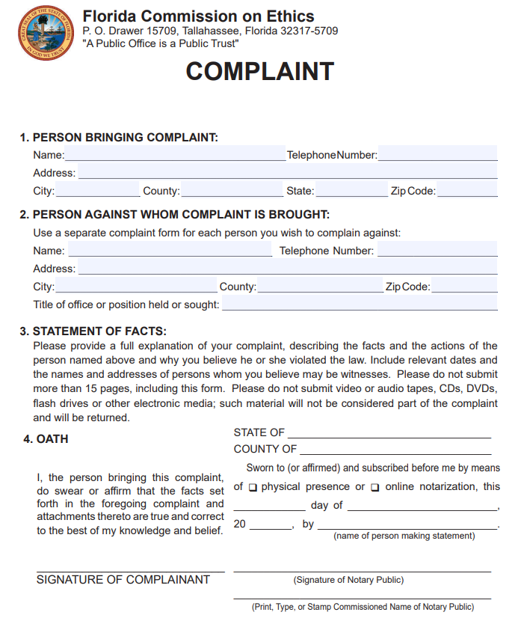
Fill in the blank form.
Simple request for statement of violation.

Slide 39
Ethics Complaints:
There is no filing fee or service of process associated with an Ethics Complaint.
Once filed the Complaint and all proceedings and records are confidential until the respondent requests the Complaint be made public OR the action is before the Commission on Ethics in a public hearing setting.
Five-year statute of limitations on Ethics Complaints.
Commission can dismiss small minor violations.

Slide 40

Potential Penalties:
Removal/suspension from office.
Impeachment.
Censure, reprimand, demotion or salary reduction.
Forfeiture of a max of 1/3 of public salary (for 1 yr. period)
Restitution of any pecuniary benefits received due to the violation.
Civil penalty of up to $10,000 $20,000 (2023)
For gift violations – up to 3x’s the value of the gift.
Daily fines ($25/day) up to $1500 for late form submittal.

Slide 41
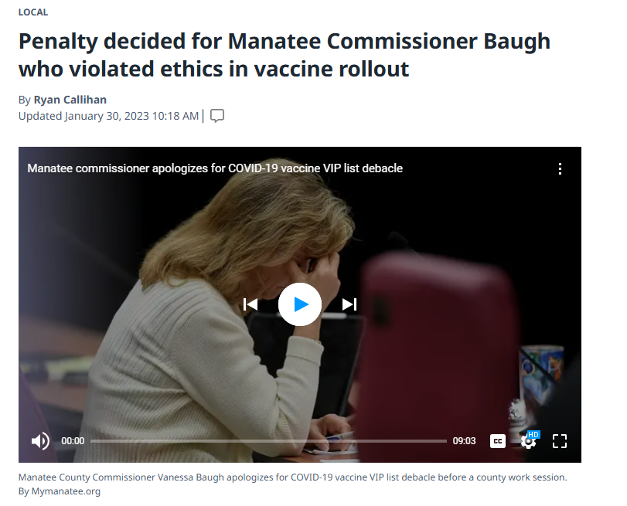
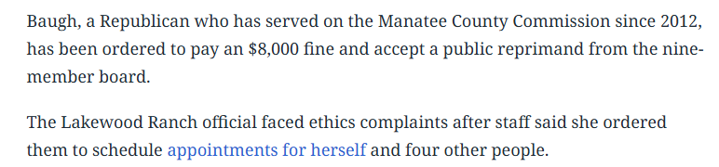
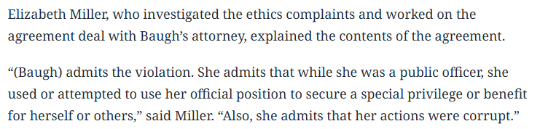
Ethics Complaint: Real Life Example
Excerpt from Bradenton Herald:

Slide 42
Oath of Office for Public Officials
'I do solemnly swear (or affirm) that I will support, protect, and defend the Constitution and Government of the United States and of the State of Florida; that I am duly qualified to hold office under the Constitution of the state; and that I will well and faithfully perform the duties of [Insert Government Name] on which I am now about to enter. So help me God.‘’
See, Sect. 5(b), Art. II, Fla. Const.

Slide 43

Indemnification & Public Service
Public officials have a right to be defended when acting in the course and scope of duties
  Florida Statutes § 111.07.
  Common law.
  District Resolution

Slide 44

When an Ethics Complaint is Filed Against You….

Slide 45

Don’t Panic!
Ethics Complaints are Confidential.
Call Your District’s Legal Counsel.
Filing of Complaint Does Not Mean Complaint Will Move Forward.
If it Does Move Forward, Find out Whether Your District Will Provide a Defense.
Inquire into Insurance Coverage.
Obtain Independent Legal Counsel.

Slide 46


Slide 47
For more information, please contact:
Andrew Cohen acohen@flgovlaw.com
(941) 306-4730
Persson, Cohen, Mooney, Fernandez & Jackson P.A.
Offices Located in:
Lakewood Ranch & Venice www.flgovlaw.com

