Slide 1
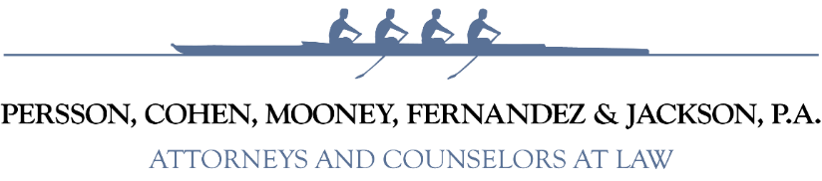

Sunshine & Public Records Laws
Presented By:
Andrew H. Cohen, Esq.
Persson, Cohen, Mooney, Fernandez & Jackson
April 30, 2026

Slide 2
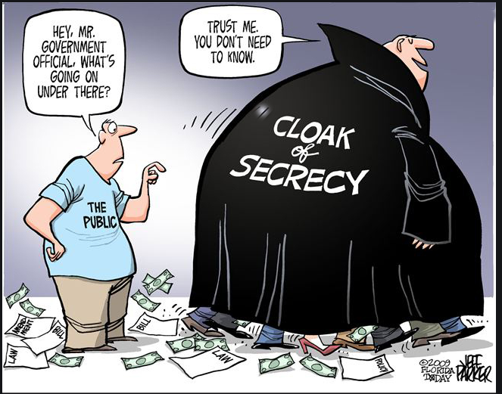
Florida’s Sunshine Law:

Slide 3
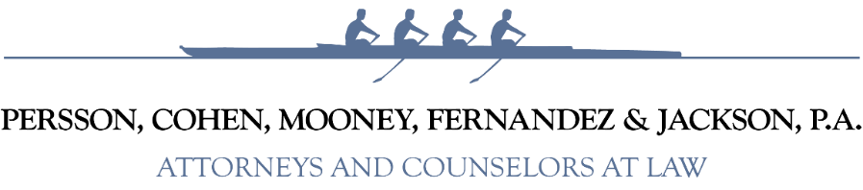
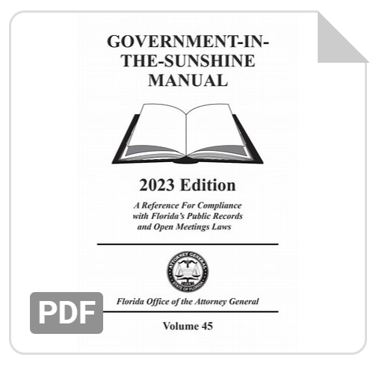
What is the Sunshine Law?
Constitutional and statutory right of the public to observe all discussions and deliberations taken by a public board.
Florida Constitution, Article I, Section 24(b)
Section 286.011, Florida Statutes
sunshinemanual.pdf (myfloridalegal.com)

Slide 4
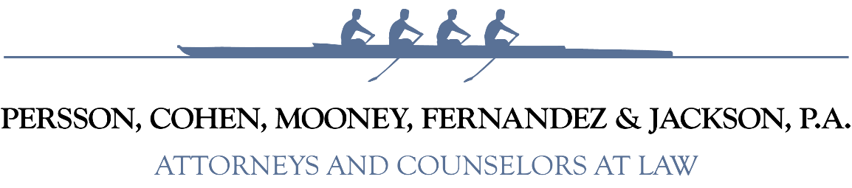
The Sunshine Law Requirements
1. Meetings of public boards or commission must be open to the public
2. Reasonable notice of such meetings must be given
3. Minutes of the meetings must be taken
See, Fla. Stat § 286.011

Slide 5
The Sunshine Law Requirements
1. Meetings of public boards or commission must be open to the public.
See, Fla. Stat § 286.011

Slide 6
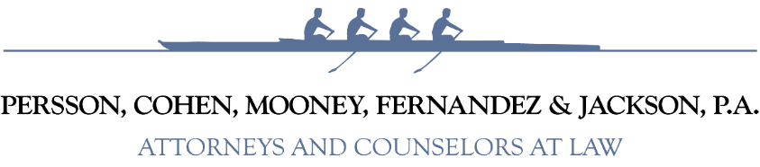
Meetings are defined as all discussions and deliberations by two or more members of the same board (whether that meeting is formal or casual) relating to a topic that is pending before the board or that is foreseeable to come before the board for action.
Meeting = Discussion of District Business

Slide 7
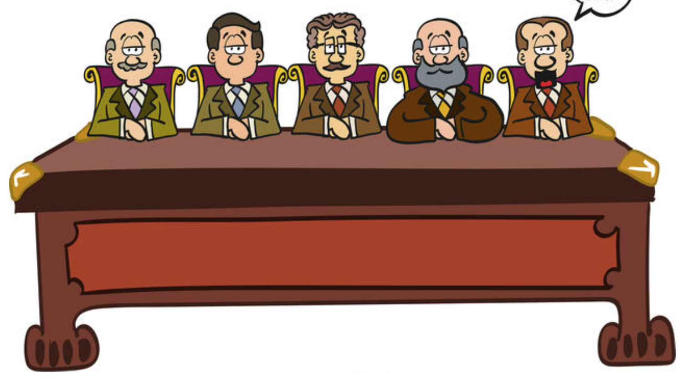
All of the members of the elected board.
All members-elect who have “won” their seat, even if they are not sworn in.
Also applies to members of any committees (appointed) by the board.
Sunshine Law Applies to Members of SAME Board

Slide 8
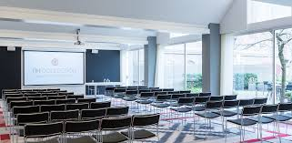

“Open to the Public” Meetings
Facilities: accessible, adequate, non-discriminatory.
No inaudible discussions.
No “Confidential” votes.
No informal/unofficial votes, and no “polling.”
The public has a right to view the meeting and hear all discussions.

Slide 9

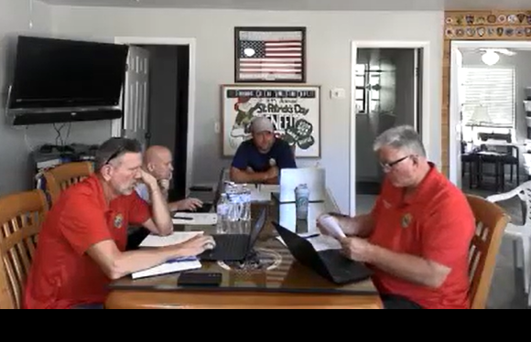
Public Business Must be Discussed Publicly

Slide 10

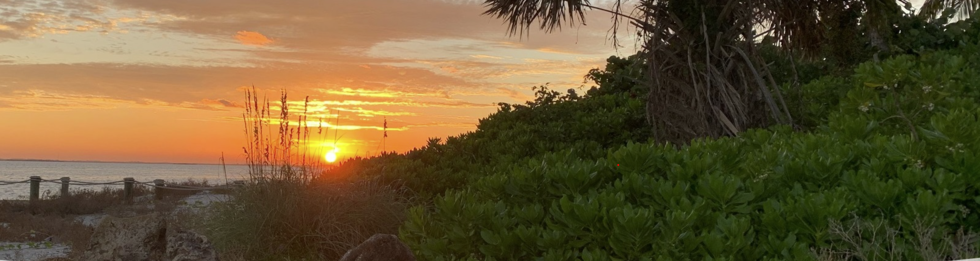

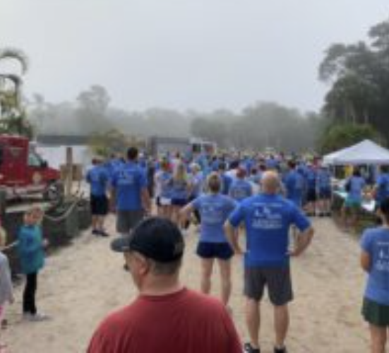


Avoid: Public Meetings Occurring Elsewhere
At Publix
At Coffee Shops
At Restaurants
At Community or Social Events
At Sporting Events
At Family Events
At the Local Pub
On the Beach….
ANYWHERE!

Slide 11

Does this mean the Sunshine Law prohibits social functions?
No, Board members may attend social functions together, so long as they have no discussion on
matters which are before or are foreseeable to come before the Board.

Slide 12
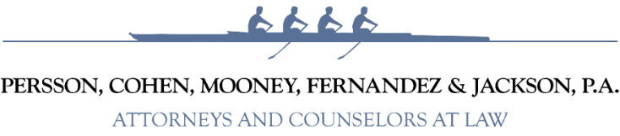





A “Meeting” Can Occur Electronically Too!
Including:
Over the Phone
Over a Text
Over Emails
Virtually
Over Social Media
i.e., Facebook, Nextdoor, X/Twitter, Instagram

Slide 13
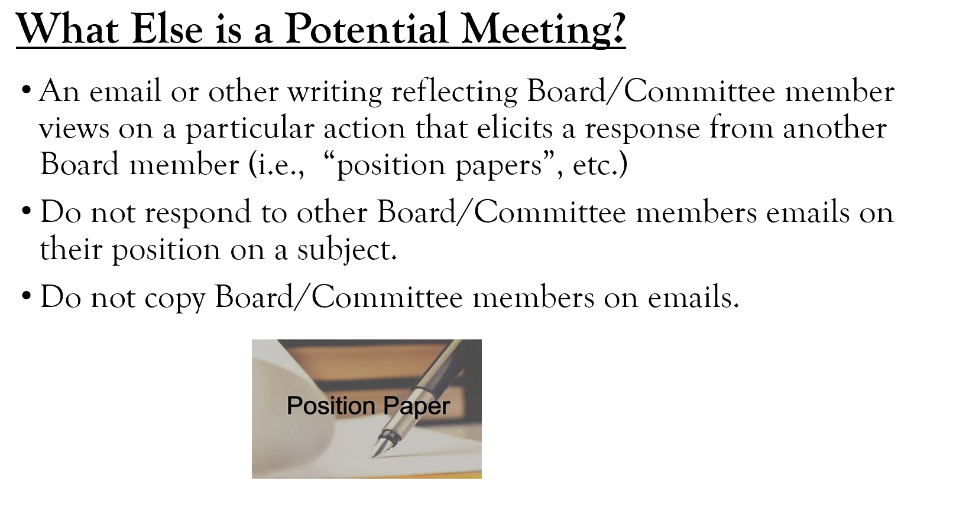

Slide 14
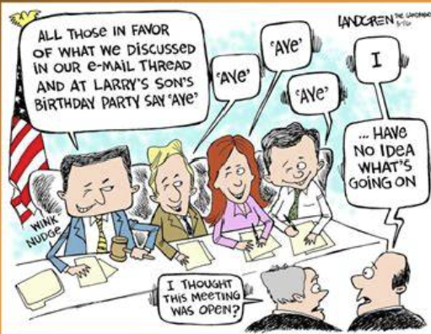

Slide 15
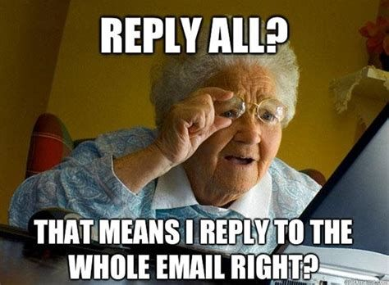

Slide 16

What about Meetings with Staff?
General rule: Board member meetings with staff are not subject to the Sunshine Law.
Exception: When staff ceases to function in a staff capacity and is delegated authority from a board to act and make selections on the District’s behalf.
Example:
Staff performing selection or RFP functions.

Slide 17
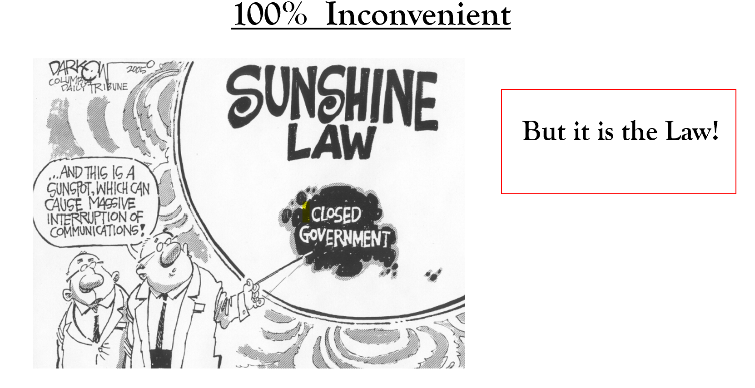

Slide 18

The Public’s Right to Speak
Florida Statutes § 286.0114 requires that the public be provided with a “reasonable opportunity” to be heard before the board takes official action.
“Reasonable” does not mean unfettered.
Difference between “public comments” during meetings and “public hearings.”
When there is a public hearing, then the public’s rights should be greater than normal limits to avoid due process issues.

Slide 19
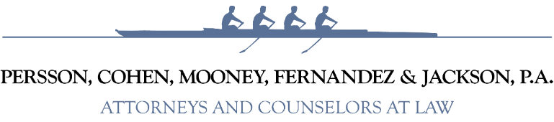
The Public’s Right to Speak
The Sunshine Law does not prevent:
the orderly conduct of public participation;
structuring agendas to provide one or more timeframes to comment;
adopting time limits on public comment; and
civility code adoption and enforcement.

Slide 20
The Sunshine Law Requirements
1. Meetings of public boards or commission must be open to the public.
2. Reasonable notice of such meetings must be given.
See, Fla. Stat § 286.011

Slide 21
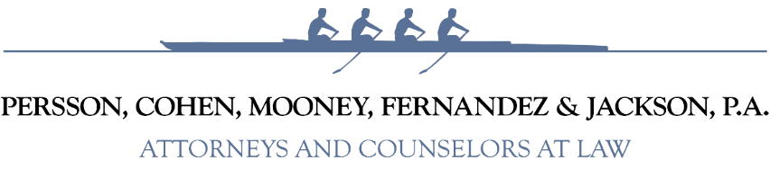


What is Reasonable Notice for Special Districts?
According to the Florida Attorney General, the general definition of “reasonable” depends on the facts of the situation and board involved.

Slide 22
Special Districts Have Special Notice Requirement!
Florida Statutes § 189.015 sets minimum notice requirements for all special districts :
  File and publish the day, time, place of regular meeting on a regular basis (quarterly, semi-annual or annual); and
  Publish the day, time, place and purpose of any special meetings or workshops at least 7 days before the meeting.

Slide 23



Emergency Meetings
Can reduce the minimum notice timeframe when a “bona fide emergency” exists.
Any action taken at an emergency meeting requires subsequent ratification by the Board at the next regular meeting.
Cannot adopt a budget using emergency exception to notice.

Slide 24

The Purpose of Notice is So the Public Can Attend
Statutory requirements are the minimum.
Can elect to provide additional notice (i.e., post on website, buildings/doors, community boards.)
Recommendation: Use additional notice(s) when holding emergency meetings

Slide 25
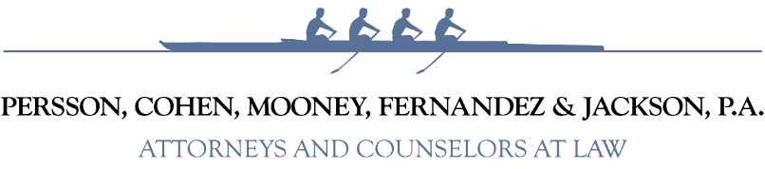
The Sunshine Law Requirements
1. Meetings of public boards or commission must be open to the public.
2. Reasonable notice of such meetings must be given.
3. Minutes of the meetings must be taken.
See, Fla. Stat § 286.011

Slide 26

What is Required Within the “Minutes”?
Defined as a “brief summary or series of brief notes reflecting the events of the meeting.”
Should reflect board action (motions and votes).
Must be promptly recorded and open to the public for inspection (includes drafts).
Staff CAN prepare minutes for Board consideration.

Slide 27

Magical Minutes DO NOT Exist!

Slide 28

What is NOT Required Within the “Minutes”?
Minutes do not need to be a verbatim transcript.
It is inconsequential to capture who said what to whom!
There is no requirement to record meetings through an audio or video tape.
*Caution: If meetings are recorded, then the recording is a public record.

Slide 29



VERY limited exceptions to the Sunshine Law.
Ongoing litigation meeting with counsel – Shade Meetings.
  Only until litigation ends.
Collective Bargaining strategy sessions.
Risk Management.

Slide 30
Penalties for Violation of Sunshine Law:
A knowing violation constitutes a 2nd degree misdemeanor, punishable by 60 days in jail and/or $500.00 fine.
Non-criminal infractions, committed without the requisite knowledge, punishable by $500.00 fine.
Both penalties are pursued by the State Attorney’s Office.
Any action taken in violation of Sunshine Law is void ab initio.
In civil actions, the law provides for the recovery of attorney’s fees for violations of this provision.
Important: Board members acting on advice of legal counsel is a defense to attorneys’ fees being assessed against the individual!

Slide 31
Real World Example:
Citizens for Sunshine v. Susan Chapman (2018)
Commissioners were alleged to have violated the Sunshine law by attending a community sponsored luncheon on homelessness.
After a 2-day trial, Judge found that Commissioner’s decision to attend the community meeting did not technically violate the Sunshine law, but that those holding public office should:
“always endeavor to avoid even the appearance of impropriety”.
The City “won” the case and spent over $400,000 in attorney’s fees defending Chapman in this litigation and appeal.

Slide 32
Real World Example: Escambia County
Former President of the Florida Senate and Chairman of the Escambia County Commission was convicted of a Sunshine Law violation for discussing public business in private with other commissioners.
He served 49 days in jail and was ordered to pay $500.00 plus $3603.85 in court costs!

Slide 33
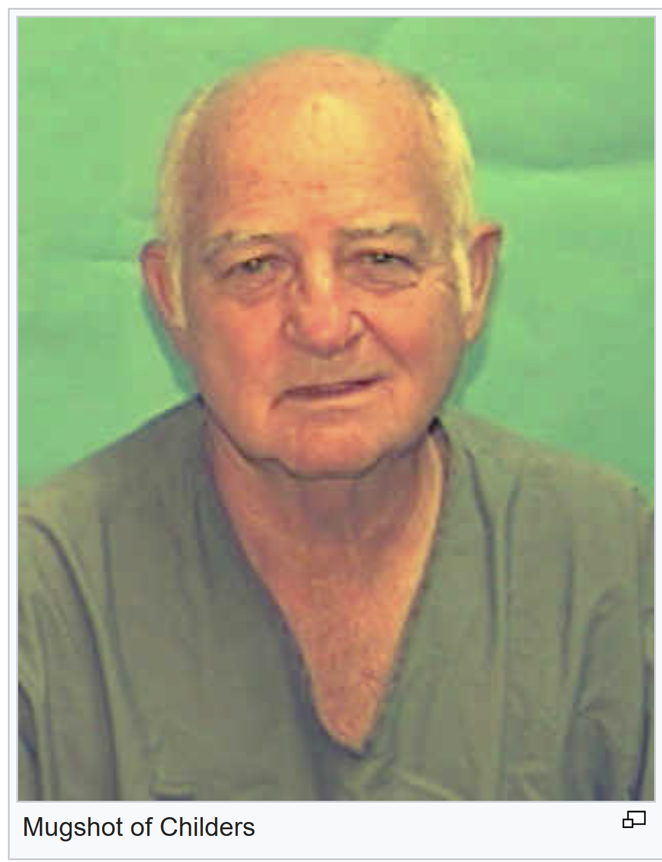
Real World Example: Escambia County
At the elected official’s sentencing Judge T. Patterson Maney wrote:
  “His crimes were more serious because he ignored the advice of the County Attorney, played a leadership role, and had vast political experience…”

Slide 34
Gilliams v. State, 2023 WL 2903901 (April 12, 2023)
City of Sebastian’s City Manager announced a noticed meeting cancellation.
3 council members held the meeting anyway, and voted to terminate the City Manager, City Attorney, City Clerk, and remove the Mayor.
All occurred in knowing violation of the Sunshine Law!

Slide 35
Gilliams v. State –Court Advice for Officials:
Meeting of 2 or more members are not allowed if any of the words pertain to possible foreseeable issues, unless the meeting is open and noticed.
Rarely is there any purpose for a private communication between 2 members.
Informal or unofficial pass-you-in-the-hallway information gathering by 2 members is subject to the Sunshine Law.

Slide 36
Gilliams v. State –Court Advice for Officials:
4) Any attempt to distinguish between formal and informal or just-listening meetings between 2 members is by itself alien to the Sunshine law.
5) Because a violation of the Sunshine Law can be charged as a crime, all of those prosecutorial techniques (subpoenas for cell records) are just a signature away.
6) When in doubt as to whether a communication (directly or indirectly) between 2 members may be illegal under the Sunshine Law – LEAVE!

Slide 37
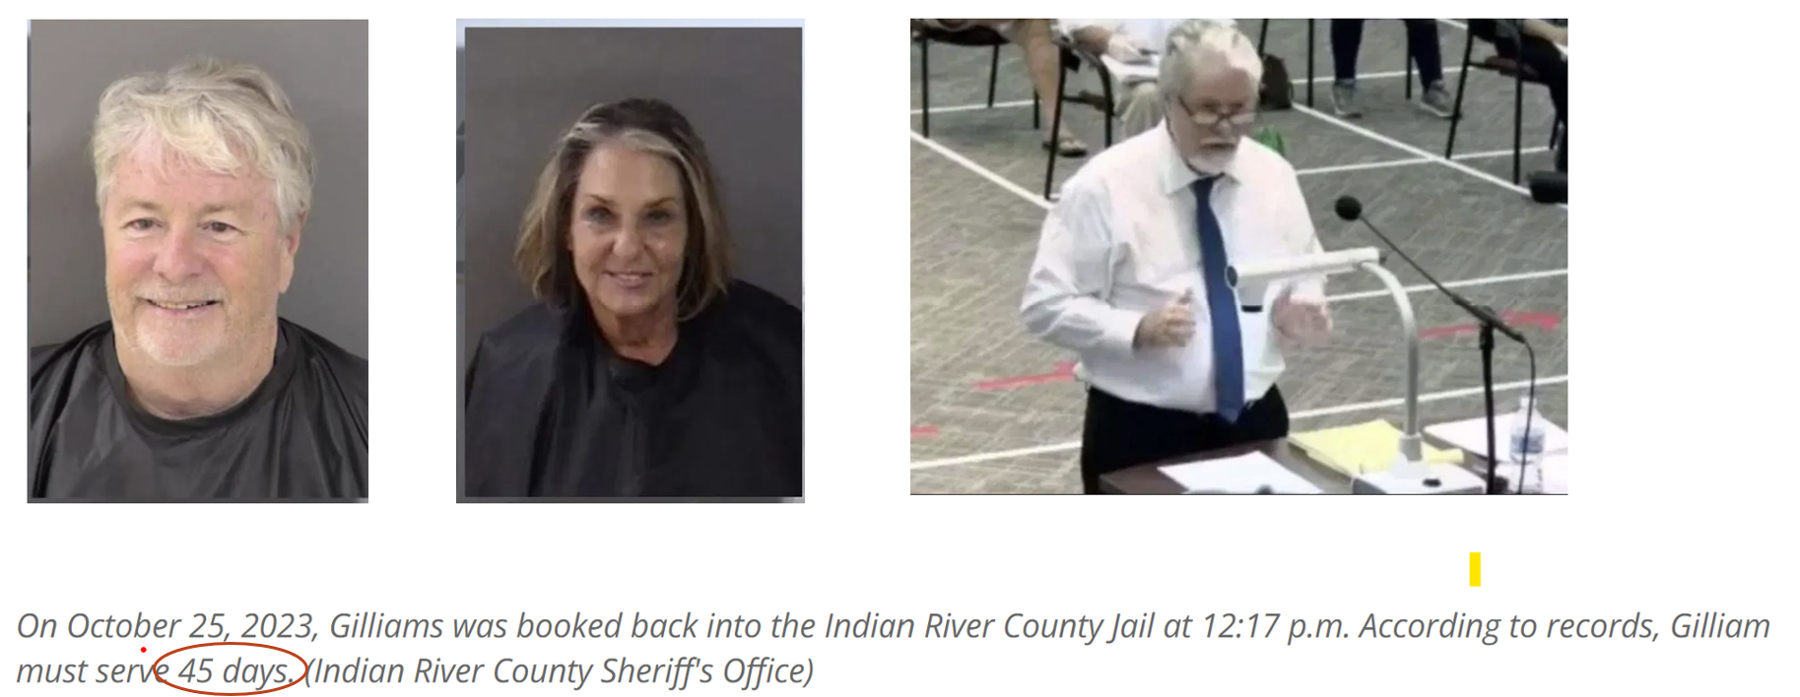
Gilliams v. State, 2023 WL 2903901 (April 12, 2023)

Slide 38
Key to the Sunshine Laws
Only Engage in Discussion of Board Topics with your Fellow Board Members in a Public Meeting Setting!

Slide 39
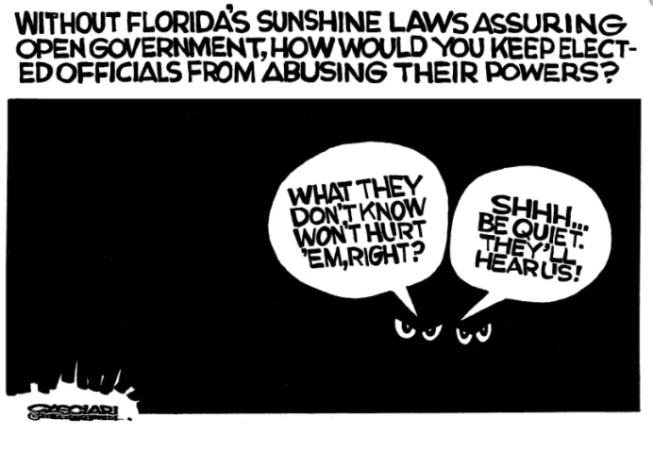

Slide 40
Quiz Time
What are the 3 basic requirements of the Sunshine Law?
Can Trustees use emails to discuss an upcoming agenda item?
Should Boards use a luncheon meeting to conduct Board business?
True or False – The Sunshine Law requires that Boards tape record their meetings for minute preservation.
Can a Board use secret ballots to elect their Chairman and Board officers?

Slide 41
Answer Time
sunshinemanual.pdf (myfloridalegal.com)
What are the 3 basic requirements of the Sunshine Law?
  Meetings must be open, reasonable notice provided, and minutes taken and promptly recorded
Can Trustees use emails to discuss an upcoming agenda item?
  No, Board may not engage in private discussions of board business.

Slide 42
Answer Time
sunshinemanual.pdf (myfloridalegal.com)
3) Should Boards use a luncheon meeting to conduct board business?
  No, because it may have a chilling effect on the public’s willingness to attend.
True or False – The Sunshine Law requires that Boards tape record their meetings for minutes preservation.
  False. The Sunshine Law requires minutes but does not require the meeting to be tape recorded.

Slide 43
Answer Time
sunshinemanual.pdf (myfloridalegal.com)
Can a Board use secret ballots to elect their Chairman and Board officers?
  No, A secret ballot violates the Sunshine Law. See AGO 72-326.

Slide 44
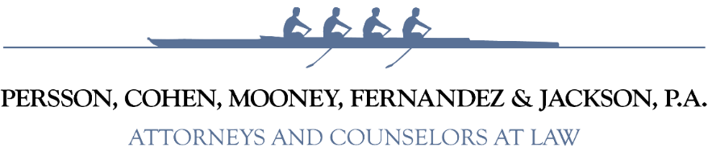
A Public Record is…
Any documents, papers, letters, maps, books, tapes, photographs, films, sound recordings, data processing software, or other material, regardless of the physical form, characteristics, or means of transmission, made or received pursuant to law or ordinance or in connection with the transaction of official business by an agency.
Art. I, s. 24, Fla. Const.; Ch. 119, Fla. Stat.

Slide 45
A Public Record is…
Any material
Prepared in connection with official agency business
Intended to perpetuate, communicate, or formalize knowledge.

Slide 46

RECORD IS SENT OR RECEIVED
Is Agency Information being Perpetuated, Formalized, or Communicated?
Yes
No
It’s a Public Record
NOT a Public Record

Slide 47
Public Records are Determined By Content
The means of record transmittal is immaterial.
Records sent from or received by personal devices (i.e., cell phone, personal email accounts, handwritten notes, etc.) are a public record if the content relates to public business.
Messages on social media accounts (i.e., Facebook, Nextdoor, etc.) are a public record if the content relates to public business.

Slide 48
Public Records are Determined By Content
Drafts and notes that are shared are a public record.
Personal records that have nothing to do with public business remain personal (even if on a District issued device).
Transitory messages are generally not a public record.

Slide 49
Public Records – Personal Devices and Accounts
Board members posting comments relating to public business on a private website “would be responsible for ensuring that the information is maintained in accordance with the Public Records Law.” Op. Att’y Gen. Fla. 08-07 (2008)
A public employee’s private cell phone text use can create an electronic public record if the message is prepared, owned, used, or retained in the scope of agency employment. Private messages may have to be reviewed by a court to determine if they are actually public business (i.e., by visibly texting on a private cell phone at a public meeting). O’Boyle v. Town of Gulf Stream, 257 So.3d 1036, 1040-1041 (Fla. 4th DCA 2018)

Slide 50

Who can request public records?
Anyone! ––“Every person has the right to inspect or copy any public record…” Art. I, Section 24, Florida Constitution
Factors you cannot consider.
A requester’s motive for wanting the records.
Whether they are a resident.
How many times they make records requests.
Whether the requestor will fill out a form.
Whether or not the requester will identify him/herself.

Slide 51
Public Records
Request for public records can be verbal!
Copying costs are prescribed by Florida Statutes.
Certain personal info. for some employees is statutorily protected (i.e., firefighters, police, HR, etc.)
Special service charges may be imposed when the nature/volume requires an extensive use of IT resources, or clerical or supervisory assistance.

Slide 52
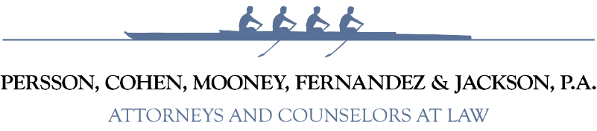
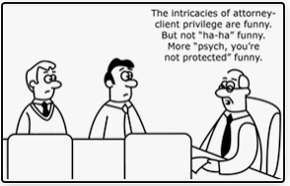
What about Communications with the District’s Attorney?

Slide 53
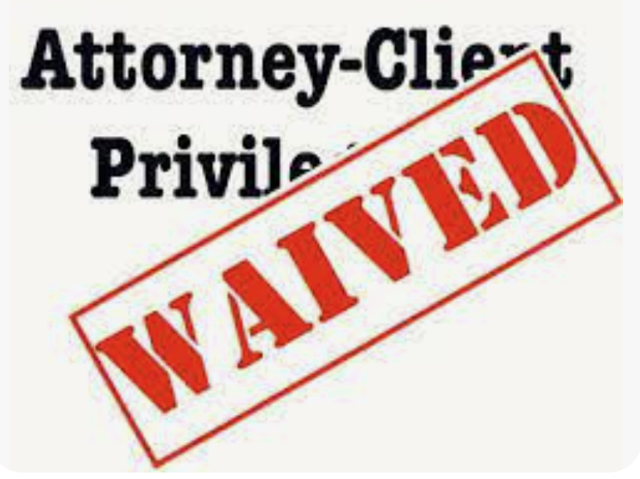
Written Communications with the District’s Attorney?
Do not expect a privilege in written communications with the District’s Attorney!
Written communications sent between a board member and the District’s Attorney are a public record (unless statutorily exempt).
Limited exemption for communications relating to active litigation or labor negotiations. Once litigation completed, the record is subject to disclosure.

Slide 54

Exemptions From Public Record
Legislature has established list of exemptions from public records throughout Florida Statutes.
To withhold all or a portion of a record (through redaction), an agency must have a statutory basis to reference.
Must cite to the statutory reference in writing.
Advisable to have the agency’s Records Custodian perform these functions.

Slide 55
Examples of Exemptions From Public Records Law
Firefighter personal information.
Social Security numbers.
Security or fire safety system plans (including evacuation plans and audio/video security footage).
Emergency notification information.
Bank account numbers, and debit, charge, and credit card numbers.
Direct deposit information.
Drug Testing pursuant to the Drug-Free Workplace Act.
Patient medical records made by health care practitioners.
Active discrimination investigations/complaints.
Active litigation work product of attorney.
Blueprints and structural layouts of buildings

Slide 56


NOT Exempt From Public Record
Job applications.
Personnel files.
Salary and Travel Records.
Concluded investigation files.
Discipline records.
Telephone records and call logs.
Litigation files (once litigation is concluded).
Background check/criminal history information is generally a public record (unless a juvenile record).

Slide 57
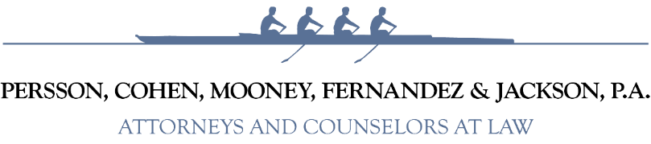
Penalties for Violations of Public Records Law:
A knowing violation constitutes: 1st degree misdemeanor (up to 1 year in jail), and/or $1,000 fine, and/or potential suspension, removal or impeachment from office.
Non-criminal infraction (committed without the requisite knowledge) is punishable by a not to exceed $500.00 fine
The above may be pursued by the State Attorney’s Office.
Also, there is a civil action provided by statute that allows for the recovery of attorney’s fees and costs for violations of this law.

Slide 58

Lorenzo v. City of Venice (2009)
Judge Bennett determined that the Venice City Council members violated the Sunshine law through emails and entered a judgment against the City of $777,114.42 in attorney’s fees and costs to the Plaintiff’s attorney.
The City also paid attorneys fees for the five (5) individual City Council members who were individual defendants in the case.
The total amount of attorneys fees paid by the City of Venice inclusive of the above judgement and legal defense was over $2,000,000!

Slide 59

Oath of Office for Public Officials
'I do solemnly swear (or affirm) that I will support, protect, and defend the Constitution and Government of the United States and of the State of Florida; that I am duly qualified to hold office under the Constitution of the state; and that I will well and faithfully perform the duties of [Insert Position Title] on which I am now about to enter. So help me God.‘’
See, Sect. 5(b), Art. II, Fla. Const.

Slide 60

Public Officials & Indemnification
Public officials have a right to be defended when acting in the course and scope of their duties.
Right to indemnification based upon:
  Common law.
  Florida Statutes § 111.07.
  Locally Adopted District Policy?
Right extends to public records and Sunshine Laws.

Slide 61

Sunshine and Public Records Headlines

Slide 62
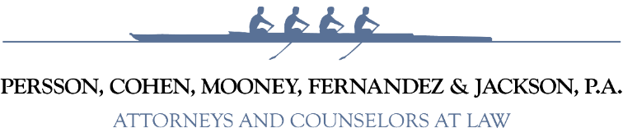
Recent Headlines
Holmes County Development Board members charged with Sunshine Law violations
by: Heather Bazley
Posted: Jun 24, 2025 / 08:46 PM CDT
Updated: Oct 22, 2025 / 10:44 PM CDT
https://www.mypanhandle.com/news/local-news/holmes-county/holmes-county-development-board-members-charged-with-sunshine-law-violations/
Lawsuit against New College of Florida over violation of public records law settled
Gabriela Szymanowska
Sarasota Herald-Tribune
May 14, 2025, 2:58 p.m. ET
https://www.heraldtribune.com/story/news/courts/2025/05/14/new-college-of-florida-sarasota-watchdog-group-settle-records-lawsuit/83603266007/?gnt-cfr=1&gca-cat=p&gca-uir=false&gca-epti=z117022p119650c119650u114122d00----v117022&gca-ft=271&gca-ds=sophi
3 St. Johns County Airport Authority Board members facing charges, accused of repeatedly violating Sunshine Laws
Travis Gibson, Executive Reporter
Chris Will, News4JAX reporter, Jacksonville
Christopher Smith, News4JAX photojournalist, Jacksonville
Published: June 27, 2025 at 5:50 PM; Updated: June 28, 2025 at 10:27 PM
https://www.news4jax.com/news/local/2025/06/27/3-st-johns-county-airport-authority-board-members-facing-charges-accused-of-violating-sunshine-laws/
MIAMI-DADE COUNTY
Lawsuit accuses Miami Dade College of violating Sunshine Law on Trump library
By Claire Heddles
Updated October 7, 2025 5:39
https://www.miamiherald.com/news/local/community/miami-dade/article312416832.html

Slide 63
Quiz Time
Are a Board member’s posted comments relating to District business on a privately operated website considered a public record?
Can text messages be a public record?
Does someone requesting public records have to explain why they want the record?
Can a District require a person requesting public records identify themselves?
True or False – If a court finds the District failed to follow the Public Records Act, the court could award attorney’s fees to the requestor.

Slide 64
Answer Time
sunshinemanual.pdf (myfloridalegal.com)
Are a Board member’s posted comments relating to District business on a privately operated website considered a public record?
  Yes, and the Board member would be responsible for ensuring that information is maintained in accordance with the Public Records Act.
Can text messages be a public record?
  Yes.

Slide 65
Answer Time
sunshinemanual.pdf (myfloridalegal.com)
Does someone requesting public records have to explain why they want the record?
  No, the motivation of the person does not impact their right to see the public record.
Can a District require a person requesting public records to identify themselves?
  No, a person requesting public records is not required to give his/her name, address, telephone number or other identifying information.

Slide 66
Answer Time
sunshinemanual.pdf (myfloridalegal.com)
True or False – If a court finds the District failed to follow the Public Records Act, the court could award attorney’s fees to the requestor.
  True. An award of attorney’s fees can be ordered in actions to enforce the Public Records Act.

Slide 67


Thank you!
Andrew H. Cohen, Esq.
acohen@flgovlaw.com
Persson, Cohen, Mooney, Fernandez & Jackson, P.A
(941) 306-4730

