Slide 1
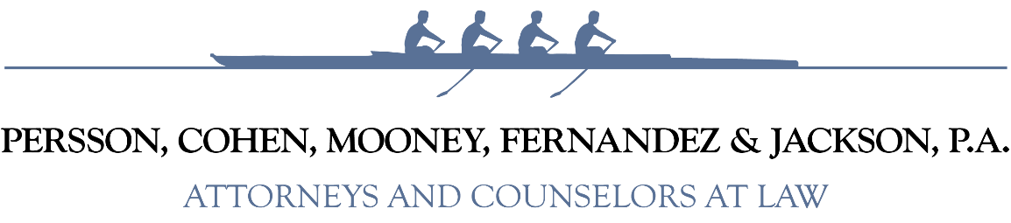

Florida’s Ethics Law Training
Ethics Law Quiz (Part 2)
Presented by:
Andrew H. Cohen, Esq.
April 30, 2026
Elected Official Training
Holiday Park Park and Recreation District

Slide 2
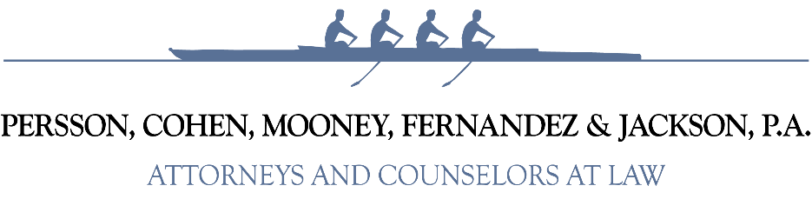
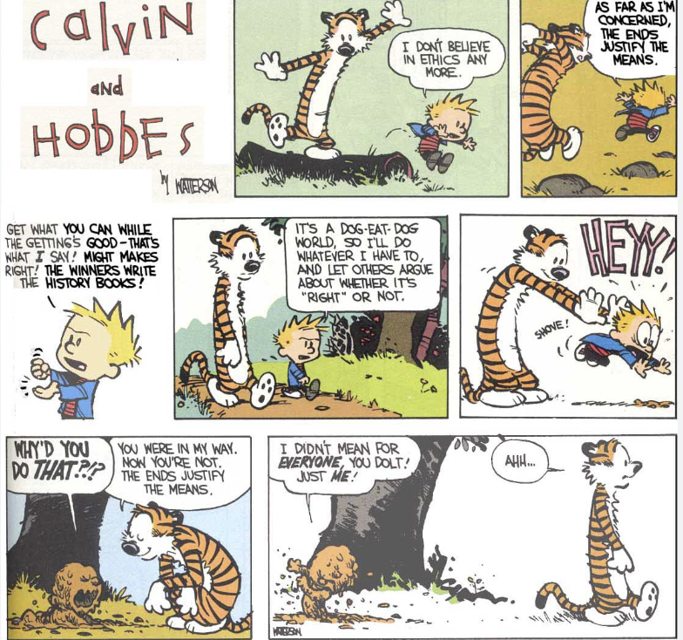
.

Slide 3
Question 1
For the past 4 ½ years, ABC Water Control District (“District”) has had a 5-year maintenance contract with the “Big Green Machine,” a nationally owned lawn and tractor retail and repair shop. The contract is due to expire in the next 6 months and The District Manager informs the Board that they will need to decide whether to extend the existing contract or competitively bid out a contract with a new vendor for a new term. None of the current Board members served on the Board 4 ½ year ago when the contract was awarded to Big Green Machine. Big Green Machine’s Owner, Sal Salesperson, has recently started attending all of the District’s monthly meetings and introduced himself to all of the District’s Board members. After last month’s meeting, Sal invites the Chairman of the Board to join him for a night on the town with a chauffeured limo ride, dinner at Bern’s Steakhouse and then a Kenny Chesney concert. At the end of the evening the Chairman offers to repay Sal for the night’s entertainment (limo ride, dinner and the concert ticket). Sal replies “Don’t worry friend, you’ll be able to reciprocate.”

Slide 4
Question 1
Which of the following is the most accurate statement relating to Florida’s Ethics law:
Since there has been no official action or decision by the current Board of the District relating to the lawn and tractor maintenance contract, there is nothing improper with Sal purchasing dinner and a concert ticket for the Chairman.
The Chairman should pay his own way for his evening out with Sal to avoid any claims that Sal influenced the decision-making process relating to the District’s lawn and tractor maintenance contract.
As long as the Chairman discloses the evening out with Sal to the rest of the District Board at a publicly noticed meeting, there is no ethics violation by the Chairman.
The Chairman can accept the gifts from Sal, because Sal is not a lobbyist and the laws prohibiting elected officials from accepting gifts only applies to lobbyists.

Slide 5
Question 1
Which of the following is the most accurate statement relating to Florida’s Ethics law:
Since there has been no official action or decision by the current Board of the District relating to the lawn and tractor maintenance contract, there is nothing improper with Sal purchasing dinner and a concert ticket for the Chairman.
The Chairman should pay his own way for his evening out with Sal to avoid any claims that Sal influenced the decision-making process relating to the District’s lawn and tractor maintenance contract.
As long as the Chairman discloses the evening out with Sal to the rest of the District Board at a publicly noticed meeting, there is no ethics violation by the Chairman.
The Chairman can accept the gifts from Sal, because Sal is not a lobbyist and the laws prohibiting elected officials from accepting gifts only applies to lobbyists.

Slide 6
Question 2
2. Using all of the same facts outlined in #1 above, assume the value of the limo ride, dinner and concert ticket was worth a total value of $95.00. Which of the following is the most accurate statement relating to Florida’s Ethics law:

Slide 7
Question 2
Which of the following is the most accurate statement relating to Florida’s Ethics law:
The Chairman’s acceptance of an evening out paid for by Sal is no longer a violation of the law because the total gift is under $100.00.
The Chairman’s acceptance of an evening out paid for by Sal would only be acceptable if the total gift was under $25.00.
The Chairman can accept gifts from Sal, because Sal is not a lobbyist and the laws prohibiting elected officials from accepting gifts only applies to gifts from lobbyists.
The Chairman should still pay his own way for his evening out with Sal to avoid any claims that Sal provided the Chairman with an unauthorized gift to influence the District’s Board’s decision making on the law and tractor maintenance contract.

Slide 8
Question 2
Which of the following is the most accurate statement relating to Florida’s Ethics law:
The Chairman’s acceptance of an evening out paid for by Sal is no longer a violation of the law because the total gift is under $100.00.
The Chairman’s acceptance of an evening out paid for by Sal would only be acceptable if the total gift was under $25.00.
The Chairman can accept gifts from Sal, because Sal is not a lobbyist and the laws prohibiting elected officials from accepting gifts only applies to gifts from lobbyists.
The Chairman should still pay his own way for his evening out with Sal to avoid any claims that Sal provided the Chairman with an unauthorized gift to influence the District’s Board’s decision making on the law and tractor maintenance contract.

Slide 9
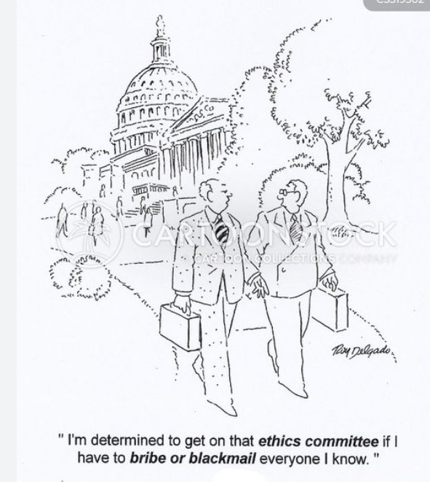

Slide 10
Question 3
3. Paulina Principle is an employee of the Padre Municipal Improvement District (“PMID”). Paulina rents an apartment and is a registered voter within the PMID. Paulina is displeased with the recent policy decisions of the PMID’s Commission relating to infrastructure funding priorities. The Chairman of PMID’s Commission is up for re-election this year. Paulina believes it is her duty to run against him and unseat him to effectuate the much needed change on the Commission. Which of the following is the most accurate statement about Florida’s Ethics laws:

Slide 11
Question 3
Which of the following is the most accurate statement relating to Florida’s Ethics law:
Since Paulina is a legal resident within the PMID, there is no issue with Paulina simultaneously serving as an employee and Commissioner at the PMID.
Paulina can serve as an employee of PMID and as an elected official but only if she is serving as an elected official at a special district other than PMID.
Paulina can only run for the Commission if she owns real property within the PMID.
Paulina can remain employed by PMID as long as she makes sure that she gets all of her work done before the Commission meetings.
Paulina can remain employed by PMID and serve as a Commissioner as long as she adjusts her priorities to agree with the existing Commission’s funding decisions.

Slide 12
Question 3
Which of the following is the most accurate statement relating to Florida’s Ethics law:
Since Paulina is a legal resident within the PMID, there is no issue with Paulina simultaneously serving as an employee and Commissioner at the PMID.
Paulina can serve as an employee of PMID and as an elected official but only if she is serving as an elected official at a special district other than PMID.
Paulina can only run for the Commission if she owns real property within the PMID.
Paulina can remain employed by PMID as long as she makes sure that she gets all of her work done before the Commission meetings.
Paulina can remain employed by PMID and serve as a Commissioner as long as she adjusts her priorities to agree with the existing Commission’s funding decisions.

Slide 13
Question 4
4. Bill has been a licensed realtor within the County for over 25 years. Bill was recently appointed to the Fire Commission to fill a vacancy. After accepting the appointment to office, Bill meets with the Fire Chief who tells Bill about the District’s need to acquire property to meet the District’s response time and growth needs. Bill asks the Fire Chief how much the Fire District has to spend on the real property. The Fire Chief replies “We have budgeted $750,000, but if we had to, we could shift funds around and spend up to $825,000.” After talking to the Fire Chief, Bill contacts one of his former clients who owns the perfect property for the Fire District’s station needs and asks if the property is for sale. The former client asks Bill, “how much is being offered?” Bill tells his former client about his discussion with the Fire Chief and indicates that the Fire District can spend $825,000. Which of the following is an accurate statement about Florida’s Ethics laws:

Slide 14
Question 4
Which of the following is an accurate statement about Florida’s Ethics laws:
Bill has violated Florida’ ethics law and misused his position by using confidential information to benefit his former client.
As long as Bill does not accept a commission on the real estate transaction, Bill will not be violating Florida’s Ethics law.
Bill has not violated Florida’s Ethics laws and should be thanked by the Fire Commission for finally securing a property that has been needed for sometime for the Fire District’s new station.
As long as Bill does not reveal that the Fire District is the buyer, Bill has not violated Florida’s Ethics law.

Slide 15
Question 4
Which of the following is an accurate statement about Florida’s Ethics laws:
Bill has violated Florida’ ethics law and misused his position by using confidential information to benefit his former client.
As long as Bill does not accept a commission on the real estate transaction, Bill will not be violating Florida’s Ethics law.
Bill has not violated Florida’s Ethics laws and should be thanked by the Fire Commission for finally securing a property that has been needed for sometime for the Fire District’s new station.
As long as Bill does not reveal that the Fire District is the buyer, Bill has not violated Florida’s Ethics law.

Slide 16
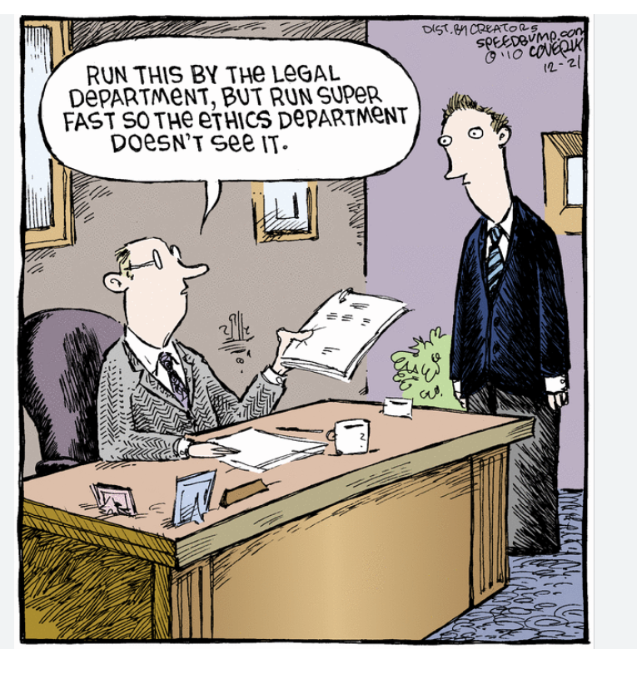

Slide 17
Question 5
5. Bill is a licensed realtor with his own real estate firm. Bill was recently elected to the Fire Commission. He meets the Fire Chief and is told about the Fire District’s difficulty finding a property for a new fire station. After the meeting with the Fire Chief, Bill gets to work and locates the perfect property for the Fire District. Bill approaches the current property owner about whether the property is for sale. The current property owner advises Bill that “everything is for sale.” Being mindful that he was just elected to office, Bill asks an associate real estate agent at his firm to handle the matter. The colleague fills out the standard Realtor Association’s Sales Contract form and sets a fair purchase price based upon the County Property Appraiser’s valuation. Bill’s colleague keeps the standard 6% realtor commission fee provision in the contract (3% payable from seller, 3% payable from buyer/Fire District) because Bill’s real estate firm put this transaction together for both parties. The entire Fire Commission considers this real estate purchase a great deal and unanimously votes to approve the contract. Which of the following is an accurate statement about Florida’s Ethics laws:

Slide 18
Question 5
Which of the following is an accurate statement about Florida’s Ethics laws:
Bill has not violated Florida’ ethics law because he “gave up” his personal commission, and the only commission that will be received will be to his colleague and real estate firm.
There is no violation of Florida’s ethics laws because Bill’s colleague handled the transaction.
Bill did not accept a commission on the real estate transaction, so Bill has not violated Florida’s Ethics laws.
Bill violated Florida’s Ethics law because as a partial owner of the real estate firm, Bill is prohibited from doing business with his District.

Slide 19
Question 5
Which of the following is an accurate statement about Florida’s Ethics laws:
Bill has not violated Florida’ ethics law because he “gave up” his personal commission, and the only commission that will be received will be to his colleague and real estate firm.
There is no violation of Florida’s ethics laws because Bill’s colleague handled the transaction.
Bill did not accept a commission on the real estate transaction so Bill has not violated Florida’s Ethics laws.
Bill violated Florida’s Ethics law because as a partial owner of the real estate firm, Bill is prohibited from doing business with his District.

Slide 20
Question 6
6. Johnny Johnson has a private lawn care and landscaping business named “Mowers R Us”. He has owned this business for over 5 years and has recently decided to expand the business to pursue larger contracts (i.e., commercial property maintenance, HOAs and Park and Recreation Districts). Unbeknownst to Johnny, Johnny’s brother Jimmy, was recently elected to the Board of Trustees of the Greenacres Park and Recreation District (“District”). The Greenacres District has gone out to bid for a new lawn care and landscaping contractor. Mowers R Us is one of 6 local vendors that has bid on the contract and Mowers R Us has submitted the lowest bid price. The award of the lawn care contract will be selected by the Greenacres District Board at the next meeting. Which of the following is an accurate statement about Florida’s Ethics laws:

Slide 21
Question 6
.
Which of the following is an accurate statement about Florida’s Ethics laws:
There is no issue with Greenacres District Supervisor Jimmy Johnson voting on the award of the lawn care contract because Supervisor Jimmy Johnson did not know that his brother was bidding on the lawn care contract.
At the meeting where the contract will be awarded, the Mowers R Us’ submittal must be disqualified, and the next lowest responsible vendor should be awarded the contract.
At the meeting where the contract will be awarded, Supervisor Jimmy Johnson must publicly disclose the conflict of interest, abstain from voting on contract award, and file a memorandum of voting conflict with the District’s secretary.
At the meeting where the contract will be awarded, Supervisor Jimmy Johnson must publicly disclose his brother’s interest in Mowers R Us, then vote on the contract award, and then file a memorandum of voting conflict with the Commission on Ethics.

Slide 22
Question 6
Which of the following is an accurate statement about Florida’s Ethics laws:
There is no issue with Greenacres District Supervisor Jimmy Johnson voting on the award of the lawn care contract because Supervisor Jimmy Johnson did not know that his brother was bidding on the lawn care contract.
At the meeting where the contract will be awarded, the Mowers R Us’ submittal must be disqualified, and the next lowest responsible vendor should be awarded the contract.
At the meeting where the contract will be awarded, Supervisor Jimmy Johnson must publicly disclose the conflict of interest, abstain from voting on contract award, and file a memorandum of voting conflict with the District’s secretary.
At the meeting where the contract will be awarded, Supervisor Jimmy Johnson must publicly disclose his brother’s interest in Mowers R Us, then vote on the contract award, and then file a memorandum of voting conflict with the Commission on Ethics.

Slide 23
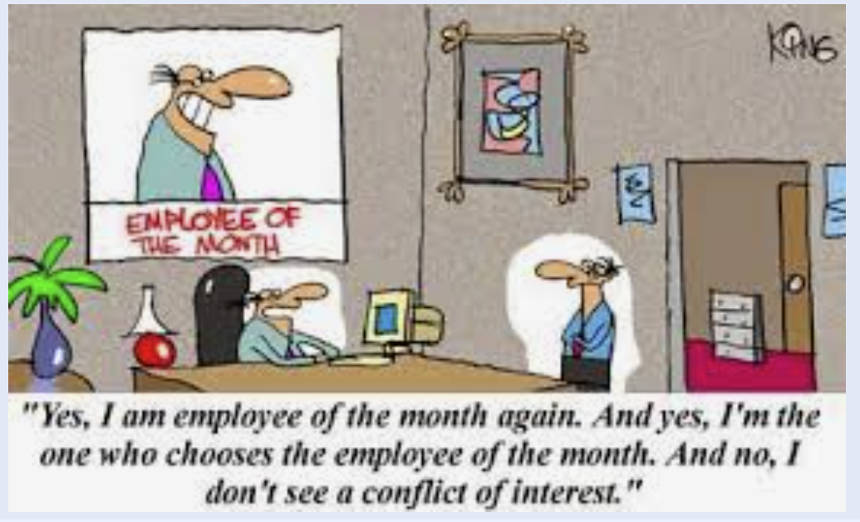

Slide 24
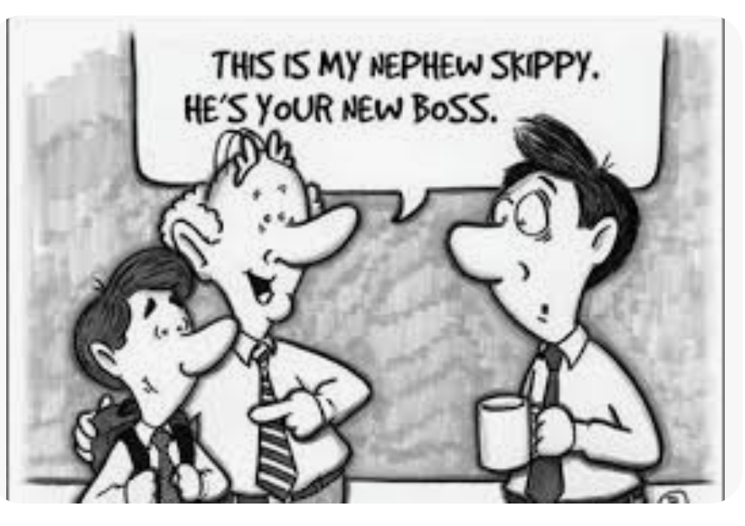
.

Slide 25
Question 7
.
7. A violation of Florida’s Ethics law is subject to the following penalties :
Impeachment, removal from office or employment, or suspension
Public censure or public reprimand
Demotion
A civil penalty not to exceed $20,000
All of the above.

Slide 26
Question 7
.
7. A violation of Florida’s Ethics law is subject to the following penalties :
Impeachment, removal from office or employment, or suspension
Public censure or public reprimand
Demotion
A civil penalty not to exceed $20,000
All of the above.

Slide 27
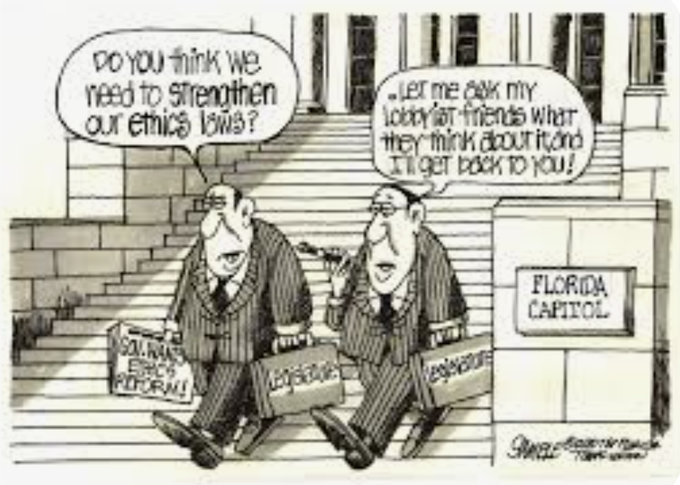
.

Slide 28
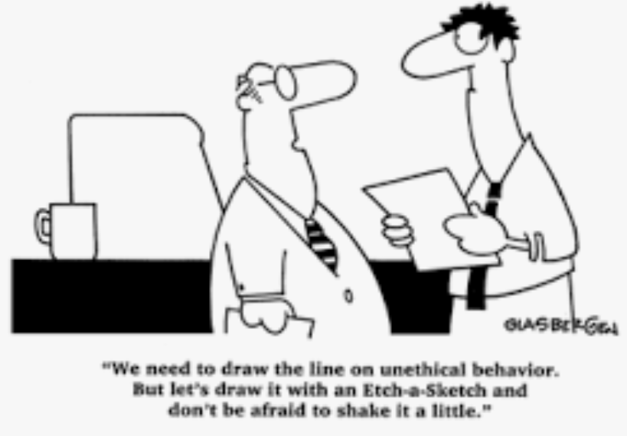
.

Slide 29
Question 8
.
8. Lavender Chill and her husband Isaac live in the Beachcity Library District (“Library District”). Lavender’s husband (Isaac) is the owner of an air conditioning company, We Cool You. We Cool You has had a longstanding A/C maintenance contract with most of the public and private commercial properties within Beachcity, including the Library District. There was a recent vacancy on the Library District Board and Lavender was appointed to fill the vacancy. Select the most accurate statement relating to Florida’s Ethics Code:

Slide 30
Question 8
.
8. Select the most accurate statement relating to Florida’s Ethics Code:
Lavender has an absolute conflict of interest under Florida’s Ethics Code and cannot serve on the Library District’s Board.
Lavender may serve on the Library District Board regardless of her spouse’s company’s contract with the District if the award of contract occurred through a sealed procurement process that Lavender was not involved in.
Lavender may not serve on the Library District Board because her spouse will derive a pecuniary interest under the existing contract and violate the prohibition on doing business with one’s agency.
Lavender may serve on the Library District Board as long as the contract with her spouse’s company does not create a continuing reoccurring conflict.
B and D.

Slide 31
Question 8
.
8. Select the most accurate statement relating to Florida’s Ethics Code:
Lavender has an absolute conflict of interest under Florida’s Ethics Code and cannot serve on the Library District’s Board.
Lavender may serve on the Library District Board regardless of her spouse’s company’s contract with the District if the award of contract occurred through a sealed procurement process that Lavender was not involved in.
Lavender may not serve on the Library District Board because her spouse will derive a pecuniary interest under the existing contract and violate the prohibition on doing business with one’s agency.
Lavender may serve on the Library District Board as long as the contract with her spouse’s company does not create a continuing reoccurring conflict.
B and D.

Slide 32
Question 9- BONUS
.
9. When in doubt of my obligations under Florida’s Ethics Laws I can contact the District’s attorney for advice on the law and as long as I follow that advice I am insulated from all liability.
  True
  False

Slide 33
Question 9- BONUS
.
9. When in doubt of my obligations under Florida’s Ethics Laws I can contact the District’s attorney for advice on the law and as long as I follow that advice I am insulated from all liability.
  True
  False
Trick Question:
District attorney can provide advice and recommendations when there are ethics law questions. However, the only way to fully insulate from liability is to obtain a written Ethics Opinion from the Commission on Ethics.

Slide 34


Slide 35
For more information, please contact:
Andrew Cohen acohen@flgovlaw.com
(941) 306-4730
Persson, Cohen, Mooney, Fernandez & Jackson P.A.
Offices Located in:
Lakewood Ranch & Venice www.flgovlaw.com

